Slide 1
Sub-Query

Slide 2
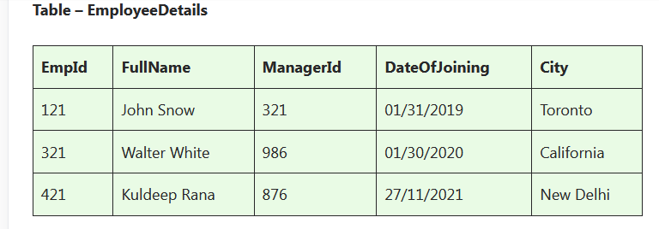
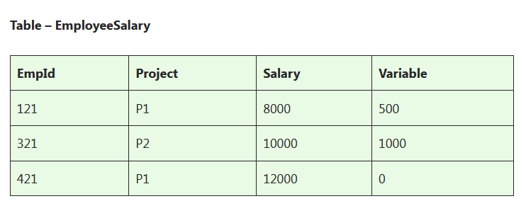

Slide 3
Write an SQL query to fetch the different projects available from the EmployeeSalary table.
Write an SQL query to fetch the different projects available from the EmployeeSalary table.
Write an SQL query to fetch the count of employees working in project ‘P1’.
Write an SQL query to find the maximum, minimum, and average salary of the employees.
Write an SQL query to find the employee id whose salary lies in the range of 9000 and 15000.
Write an SQL query to fetch those employees who live in Toronto and work under the manager with ManagerId – 321.

Slide 4
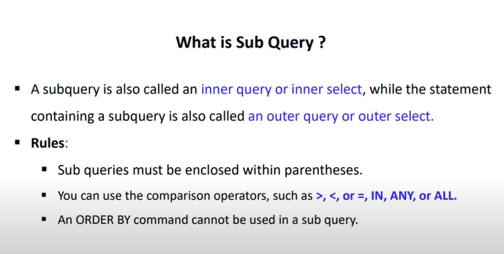

Slide 5
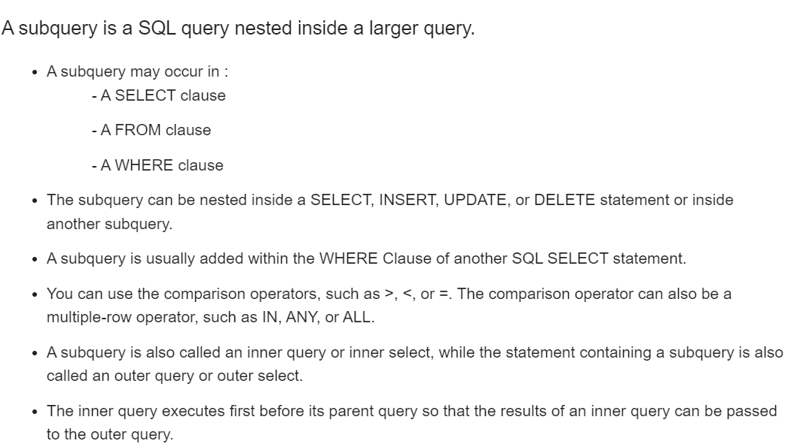

Slide 6
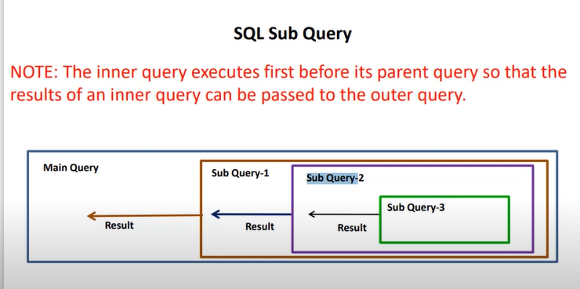

Slide 7
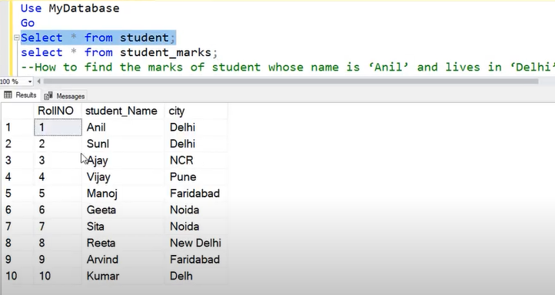

Slide 8
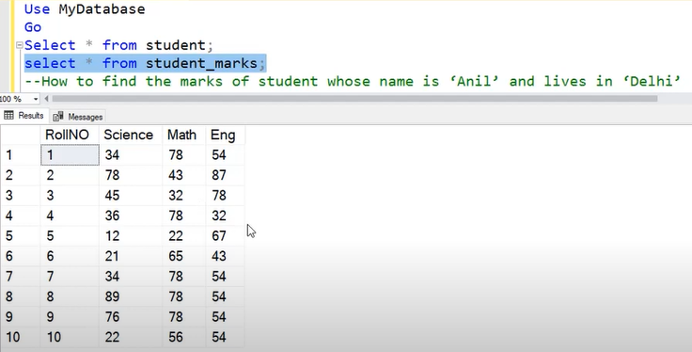

Slide 9
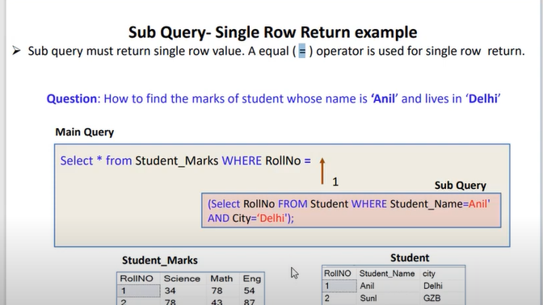

Slide 10
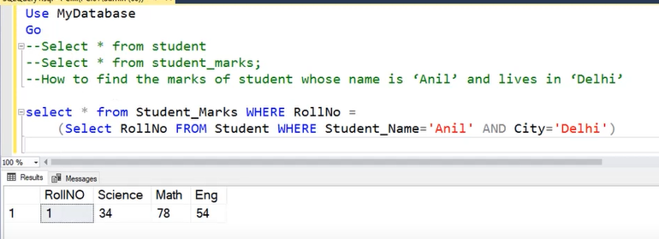

Slide 11
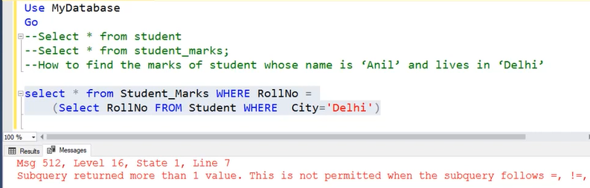

Slide 12
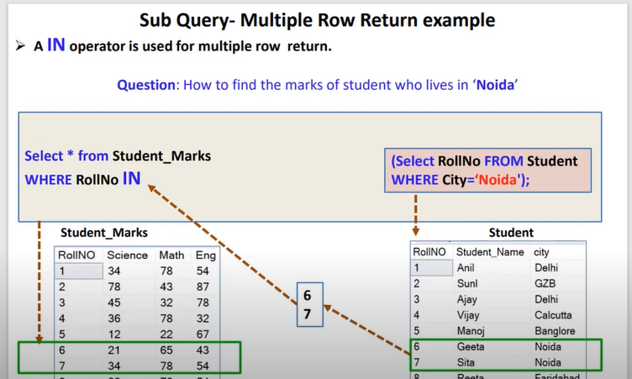

Slide 13
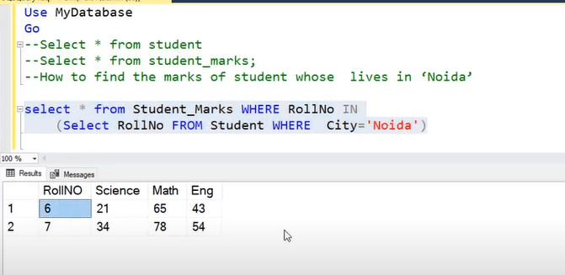

Slide 14
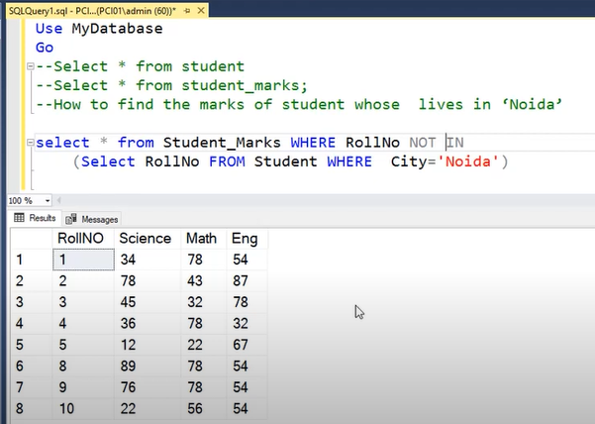

Slide 15
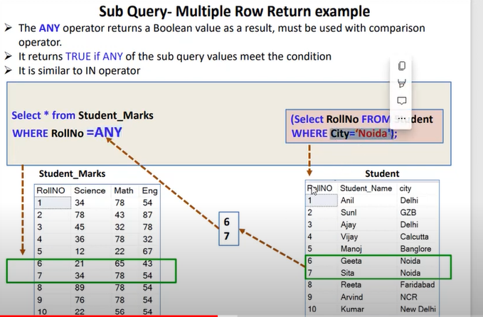

Slide 16
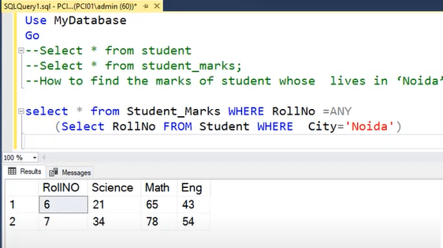

Slide 17
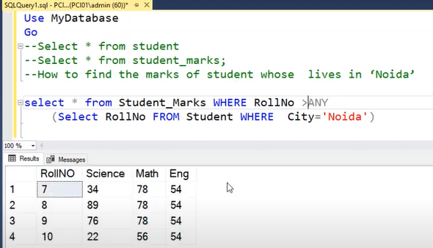

Slide 18
